Slide 1
Quantifying uncertainty
Silvia Caldararu
Email: caldaras@tcd.ie

Slide 2
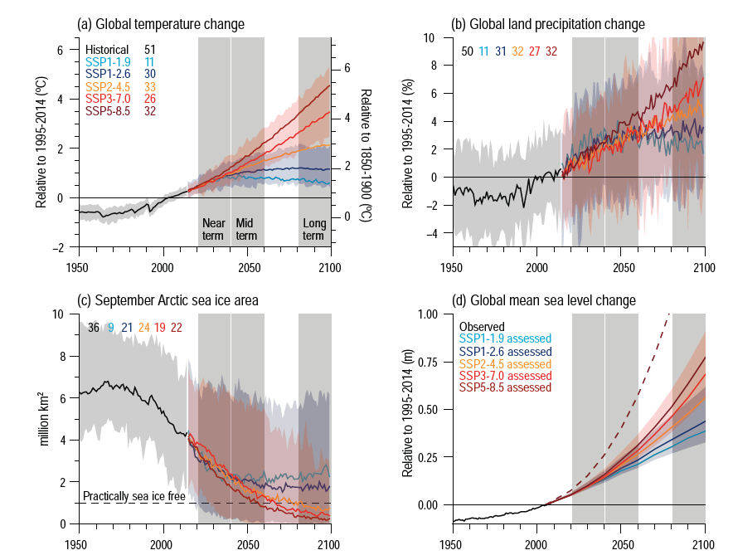
What are these predictions? What is uncertainty?

Slide 3
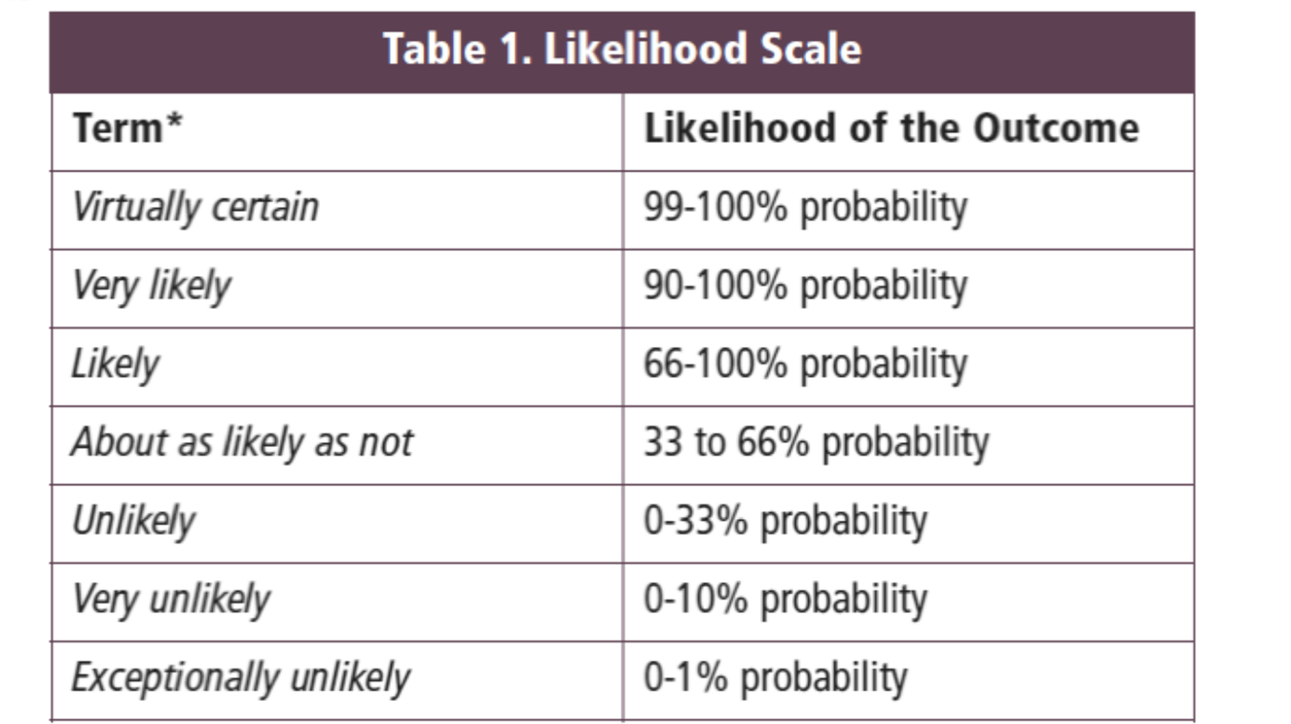
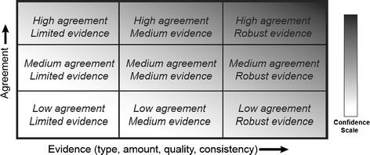
IPCC calibrated language
EXAMPLE: We can say with high confidence that this event is unlikely

Slide 4
What is uncertainty?
1.a. The quality of being uncertain in respect of duration, continuance, occurrence, etc.; liability to chance or accident. Also, the quality of being indeterminate as to magnitude or value; the amount of variation in a numerical result that is consistent with observation.
2. a. The state of not being definitely known or perfectly clear; doubtfulness or vagueness.

Slide 5
Uncertainty often has a bad connotation in day to day language
1.a. The quality of being uncertain in respect of duration, continuance, occurrence, etc.; liability to chance or accident. Also, the quality of being indeterminate as to magnitude or value; the amount of variation in a numerical result that is consistent with observation.
2. a. The state of not being definitely known or perfectly clear; doubtfulness or vagueness.

Slide 6
What is uncertainty in scientific terms
1.a. The quality of being uncertain in respect of duration, continuance, occurrence, etc.; liability to chance or accident. Also, the quality of being indeterminate as to magnitude or value; the amount of variation in a numerical result that is consistent with observation.
2. a. The state of not being definitely known or perfectly clear; doubtfulness or vagueness.

Slide 7
The IPCC definition
A state of incomplete knowledge that can result from a lack of information or from disagreement about what is known or even knowable. It may have many types of sources, from imprecision in the data to ambiguously defined concepts or terminology, incomplete understanding of critical processes, or uncertain projections of human behaviour. Uncertainty can therefore be represented by quantitative measures (e.g., a probability density function) or by qualitative statements (e.g., reflecting the judgement of a team of experts)

Slide 8
IPCC calibrated language
Qualitative statements
Quantitative measures

Slide 9
Why do we need to report uncertainty?
Why not just say:
The temperature in 2051 will be 1.63 degrees higher than the historical average

Slide 10
Uncertainty for decision making
A model of how long it takes to get to college
T_{arrival} = T_{departure} + t_{walk to station} + t_{on the train} + t_{walk to department}
t_{walk to station} = 10 minutes
t_{on the train} = 35 minutes
t_{walk to department} = 5 minutes

Slide 11
Uncertainty for decision making
A model of how long it takes to get to college
T_{arrival} = T_{departure} + t_{walk to station} + t_{on the train} + t_{walk to department}
t_{walk to station} = 10 minutes
t_{on the train} = 35 minutes
t_{walk to department} = 5 minutes
I’ll meet you at 10
vs.
I’ll meet you at 10 but I might be late
vs.
I’ll meet you at 10 but if I miss the DART I’ll actually be there at 10.20

Slide 12
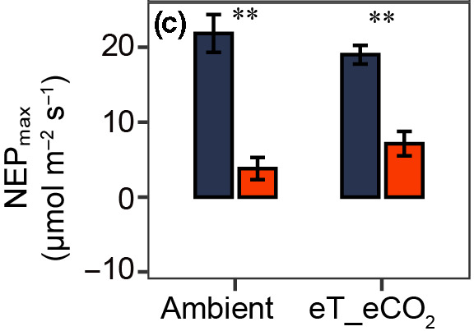
Uncertainty in observations
Multiple observations of the same quantity.
Height of bar – mean value
Errorbar (uncertainty) - standard deviation or standard error
Source of uncertainty – natural variability

Slide 13
Uncertainty in models
Shaded areas???
Multiple lines???

Slide 14
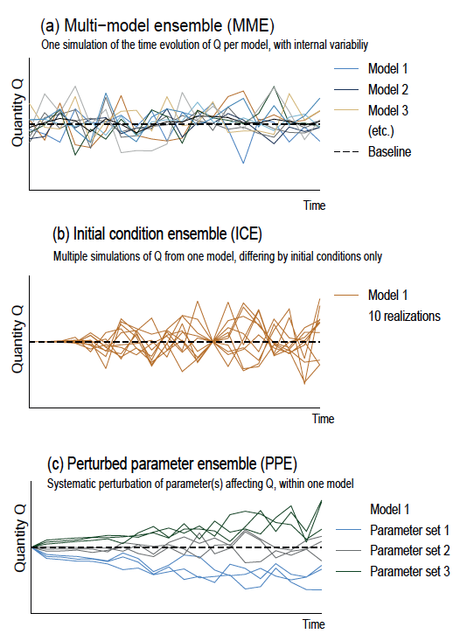
Different types of uncertainty in climate projections
Notes:
IPCC AR6 WG I, chapter 1.5 Figure 1.21

Slide 15
General model structure
Emission scenarios
Process representation
Atmosphere
Ocean
Initial conditions
Land surface
Sea ice
Model predictions
Model parameters

Slide 16
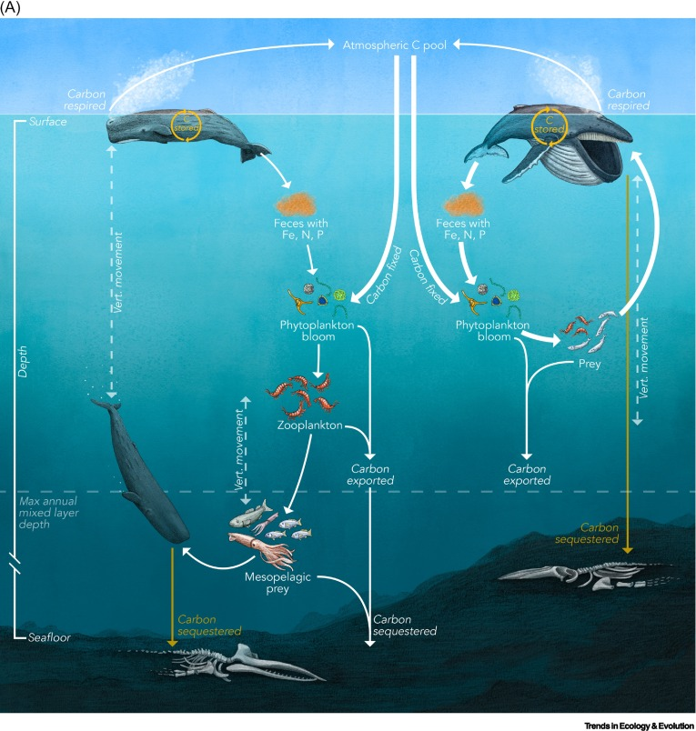
Process uncertainty – things we don’t know
New research, new insights, missing processes in models

Slide 17
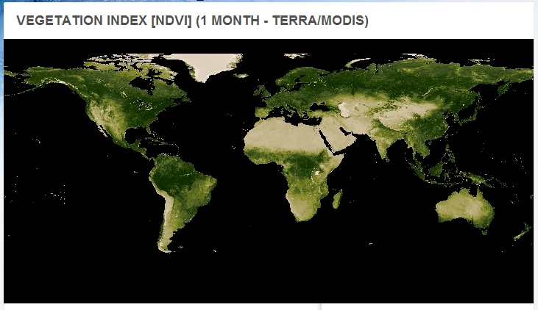

Process uncertainty – a question of scale
Approximation
Knowledge at plant level, measurements at plant and ecosystem level, model at global level

Slide 18
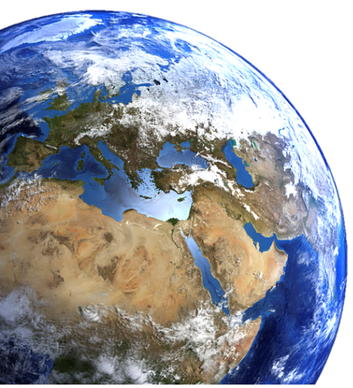
1950s
Physics-driven atmospheric circulation models
Atmospheric-ocean coupling
The carbon cycle - biology on land and in the oceans
Newer components have more unknowns, older ones more scaling problems
1990s
Human influence - land use change and emission scenarios
Present

Slide 19
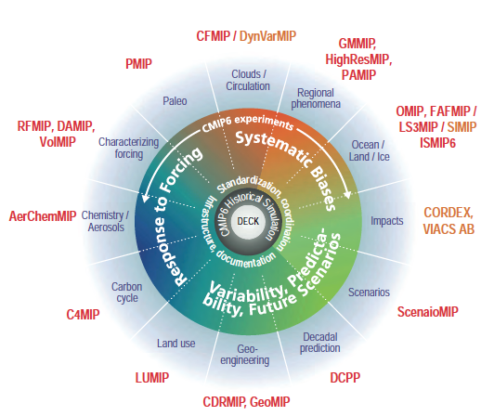
Model intercomparison projects
Many models with different process representations all put together

Slide 20
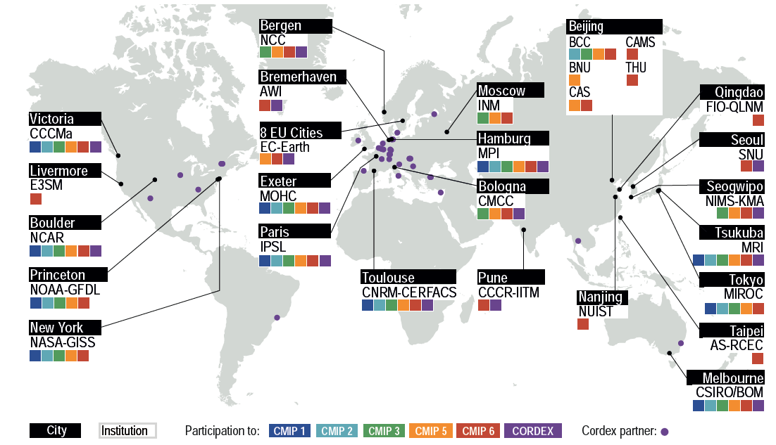
Models from all across the globe

Slide 21
Uncertainty in models
Each line is the mean of all models
Shaded areas are the range of all models – min to max
Numbers in the legend – number of models for each line
One of the main ways to represent uncertainty in IPCC output

Slide 22
Different types of uncertainty in climate projections

Slide 23
Parameter uncertainty
A model of how long it takes to get to college
T_{arrival} = T_{departure} + t_{walk to station} + t_{on the train} + t_{walk to department}
t_{walk to station} = 8-12 minutes
t_{on the train} = 35-50 minutes
t_{walk to department} = 5-10 minutes
T_{departure}=8.30
T_{arrival}=9.18-9.42 (uncertainty range)

Slide 24
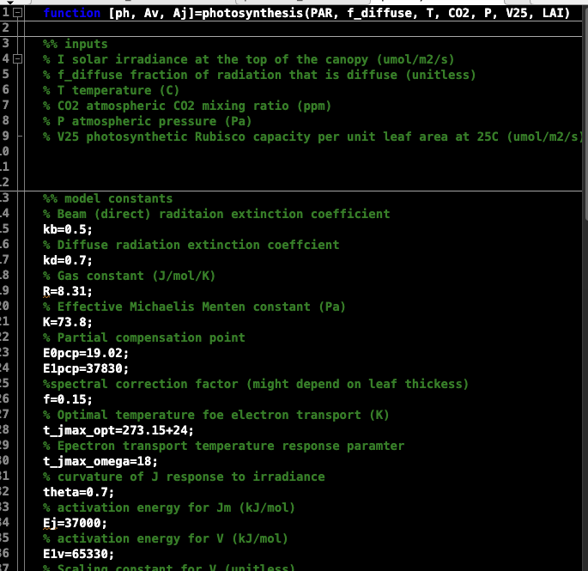
Parameter uncertainty in practical 2
Photosynthesis
You varied parameters and looked at their effect on model output:
Photosynthetic capacity
Leaf thickness
Leaf area index

Slide 25
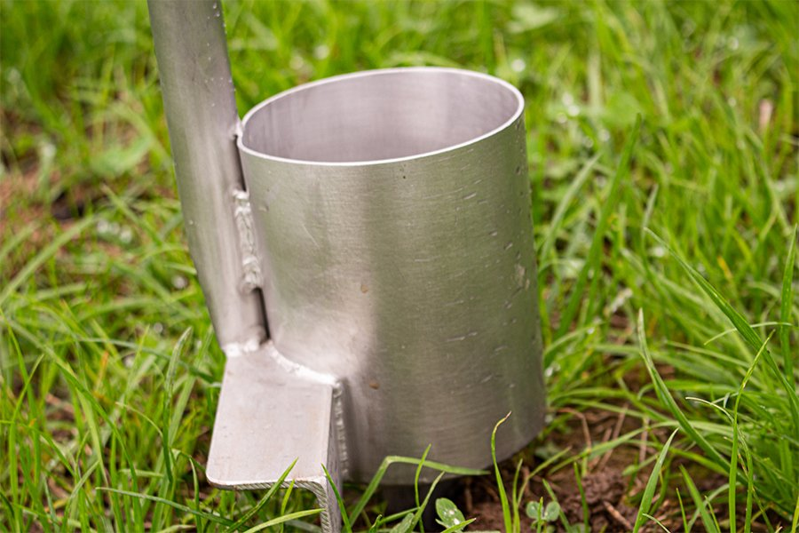
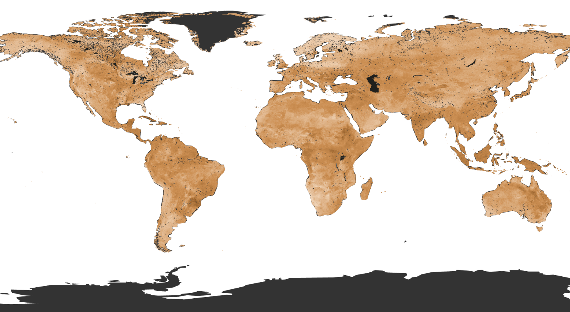
Parameter sources of uncertainty
Scaling from local measurements
Sparse measurements
Values that have no real world correspondent due to scalling approximations
Small scale observations
Parameter sensitivity tests performed before inclusion in IPCC analysis and not normally shown

Slide 26
Different types of uncertainty in climate projections

Slide 27
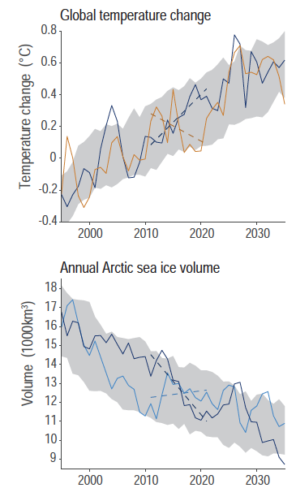
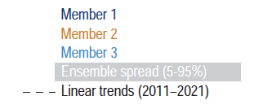
Uncertainty from internal climate variability
Natural climate variability can be large and mask climate change effects
Range is from one model with the same process representation and parameter value but different sources of climate variability (e.g. volcanic eruptions, ENSO)

Slide 28
Uncertainty in models
What are the different lines?

Slide 29
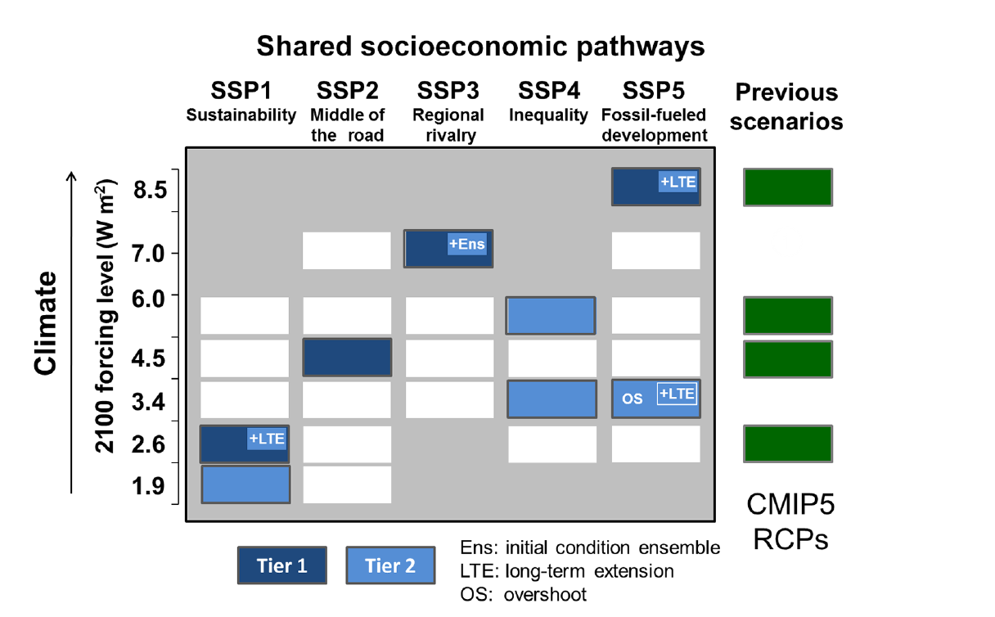
Future emissions scenarios
In the next lecture!

Slide 30
Uncertainty in models
Each line is the mean of all models for each SSP
Shaded areas are the range of all models – min to max
Colours in the legend – different SSPs
Numbers in the legend – number of models for each line

Slide 31
IPCC calibrated language
Qualitative statements
Quantitative measures

Slide 32
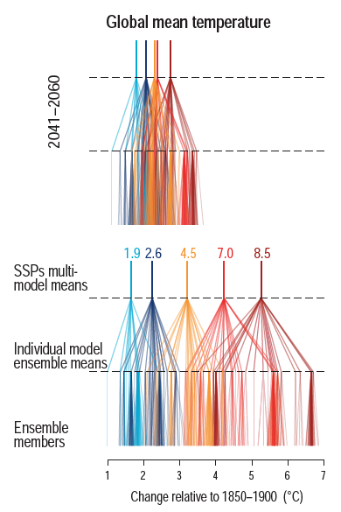
Adding up sources of uncertainty
2041-2060
Uncertainty stacks up from different sources to give the final mean and range for each SSP
Uncertainty increases in time
2061-2100

Slide 33
Uncertainty increases in time
A model of how much money is collected in a donation box
S(t) = S(t-1) + N_{people} * s
Parameter uncertainty: s=0.3 or s=0.5
t=1: S(1)= 0 + 10*0.3 = 3 OR S(1)= 0 + 10*0.5 = 5
t=2: S(2)= 3 + 15*0.3 = 7.5 OR S(2) = 5 + 15*0.5 = 12.5
t=3: S(3)= 7.5 + 5*0.3. = 9 OR S(3) = 12.5 + 5*0.5 = 15

Slide 34
Uncertainty increases in time
Increase in aboveground plant biomass AGB
AGB(t) = AGB(t-1) + A(T, PAR, LAI(t-1), Vcmax) – R(T, LAI(t-1), r)
Input/initial conditions uncertainty
Parameter uncertainty
Feedback increasing uncertainty – leaf mass depends on photosynthesis at previous timestep

Slide 35
Adding up sources of uncertainty
2041-2060
Uncertainty stacks up from different sources to give the final mean and range for each SSP
Uncertainty increases in time
2061-2100

Slide 36
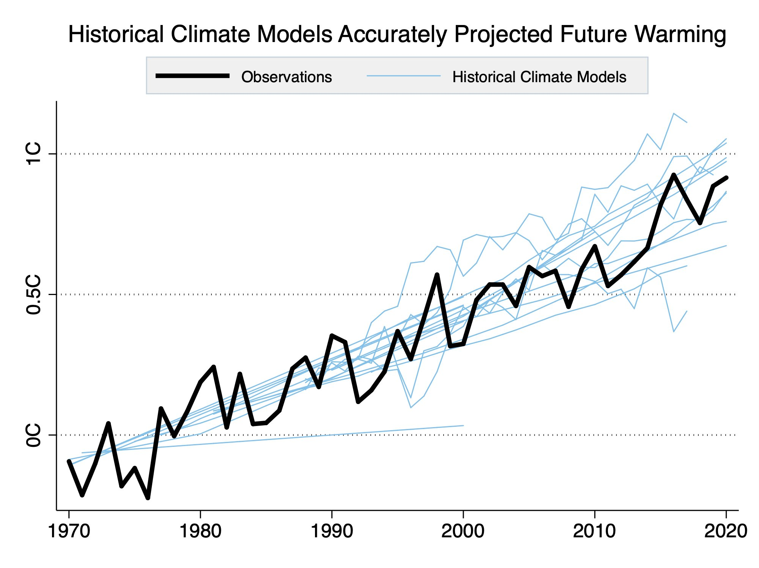
If they’re so varied, how do we know the models are right?
All models are tested against historical data before used for future projections
Lecture 14 - Observations

Slide 37
Dynamics model predictions
Model simulations are constantly updated as new information comes in

Slide 38

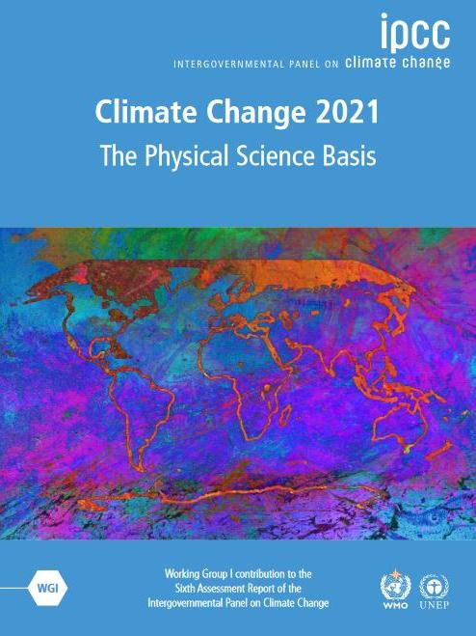
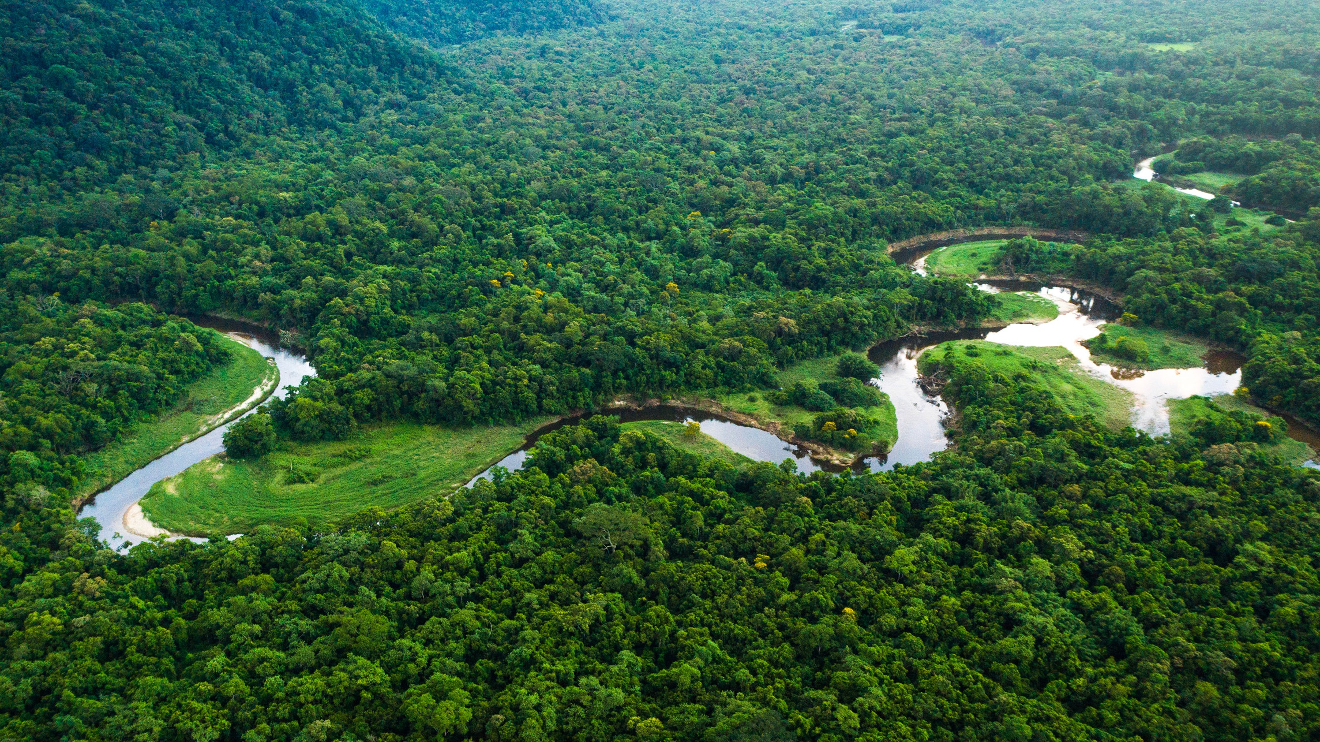

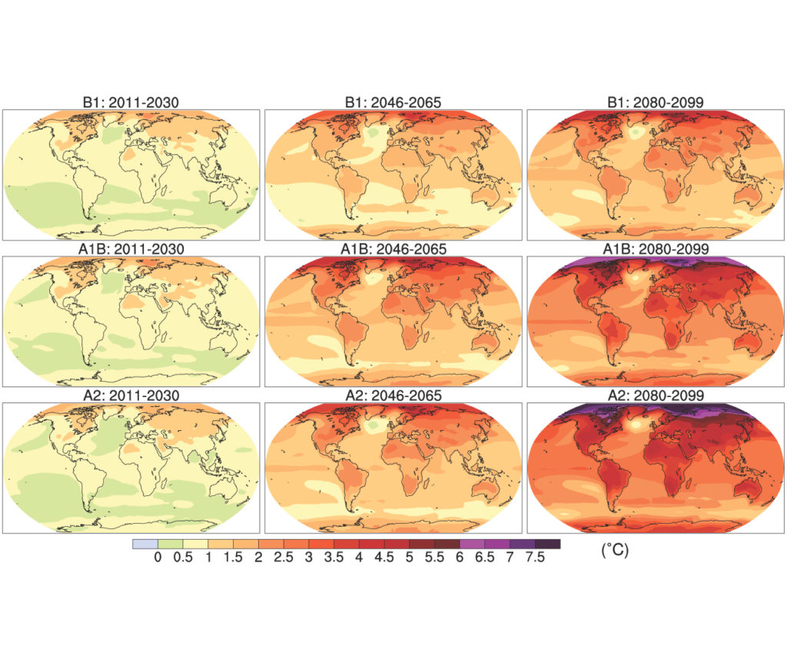
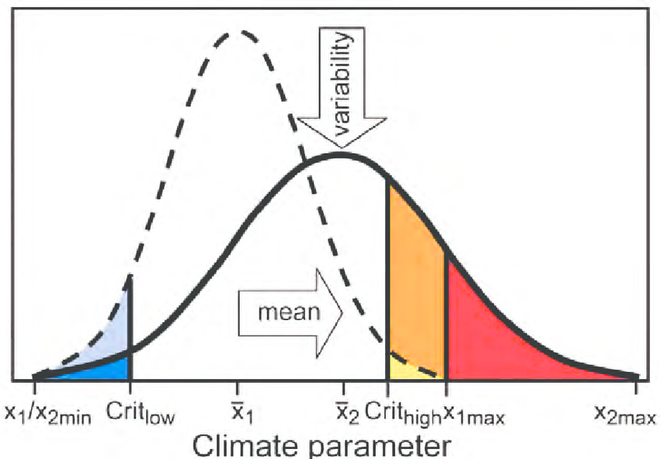
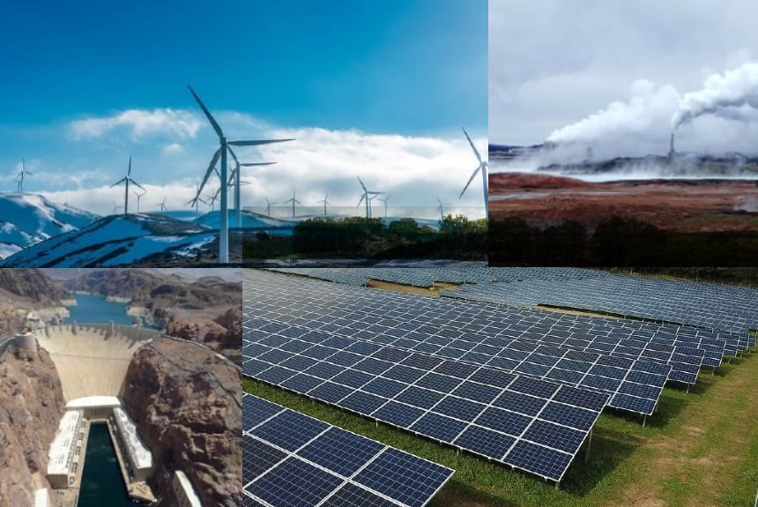
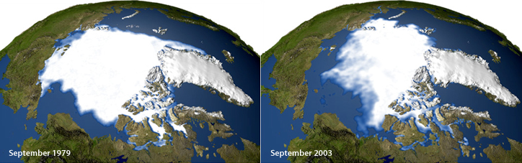
Atmosphere
Climate fundamentals
Predicting climate
Atmosphere
Global C cycle
IPCC report
Earth system models
Climate impacts
Climate solutions
Extreme events
Tipping points
Sea ice, ice caps,
Energy
Mitigation
Nature-based solutions

